Slide 1
AN E-COMMERCE COMPANY'S PATH TO SUSTAINABLE GROWTH

Slide 2
COMPANY’S BACKGROUND
E-commerce and Online Retail refer to the exchange of goods and services conducted through internet-based platforms.
These include Business-to-Business (B2B), Business-to-Consumer (B2C), and Consumer-to-Consumer (C2C) interactions.
Transactions are facilitated through websites, mobile applications, and online marketplaces.
Offers convenience, wider market access, efficient payment solutions, and digital record-keeping.
Rapidly expanding due to increased internet penetration, adoption of digital payment systems, and evolving consumer preferences.

Slide 3
PROBLEM STATEMENT
Operational Challenges: Inefficiencies in inventory, order processing, shipping, and returns are disrupting smooth operations.
Impact on Growth & Customers: These issues hinder business growth and lower customer satisfaction through delays, errors, and poor service.
Data-Driven Approach: The company is leveraging operational data to identify root causes and guide improvements.
Optimization & Strategy: Using insights to streamline processes, boost efficiency, and shift towards a data-driven, customer-focused business model.
Strategic Optimization: Insights are used to streamline processes, reduce errors, and build a data-driven, customer-focused business.

Slide 4
Data Quality & Preparation: Addressing missing values, correcting data types (e.g., date conversion), and defining valid orders were essential for reliable analysis. Data Structuring: Proper grouping by categories, states, cities, and fulfillment types required consistent categorization and handling inconsistencies. Business Interpretation: Translating metrics like cancellations, AOV, and fulfillment performance into actionable insights demanded strong business context. Data Limitations: The dataset lacked additional inputs (e.g., demographics, marketing, customer feedback), restricting deeper insights into customer behavior and market trends.
CHALLENGES

Slide 5
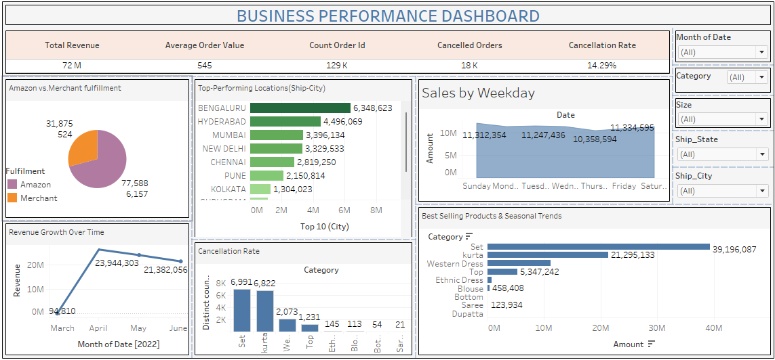

Slide 6
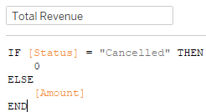



KPIS AND THEIR FORMULAS

Slide 7
KPIS AND THEIR FORMULAS
Total Revenue:
Formula excludes cancelled orders by checking the “Status” field
If the order is cancelled, revenue is counted as 0; otherwise, the “Amount” is included.
Average Order Value (AOV):
Calculated using the median of total revenue per order, which provides a measure of typical customer spending.
Count of Orders:
Simply counts the number of unique Order IDs, giving the total order volume.
Cancelled Orders:
Uses a condition to identify orders where Status contains “Cancelled” and counts them separately.
Cancellation Rate:
Ratio of cancelled orders to total orders, expressed as a percentage: (CancelledOrders ÷ TotalOrders)×100(Cancelled Orders ÷ Total Orders) × 100(CancelledOrders ÷ TotalOrders)×100
Helps measure order reliability and customer experience issues.

Slide 8

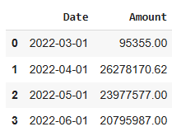
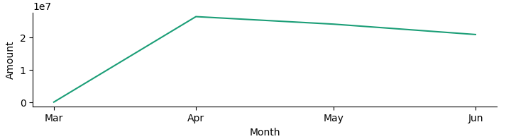
FINANCIAL PERFORMANCE ANALYSIS
Analyzing total revenue growth over time.
Total Revenue Growth Over Time

Slide 9
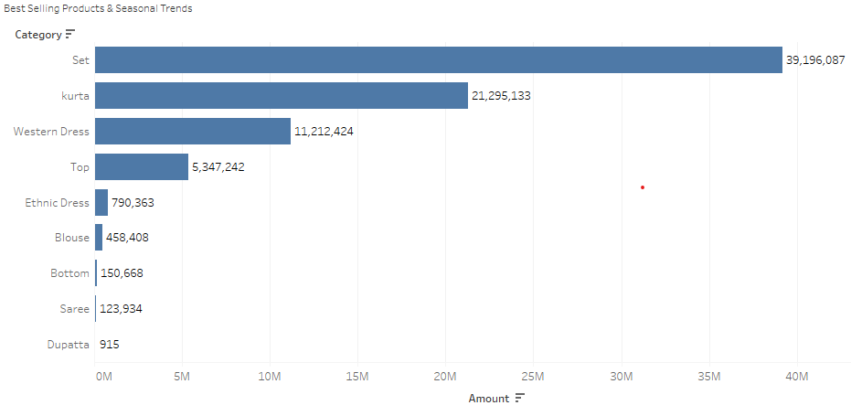
FINANCIAL PERFORMANCE ANALYSIS
Identifying best-selling products and seasonal sales trends.

Slide 10
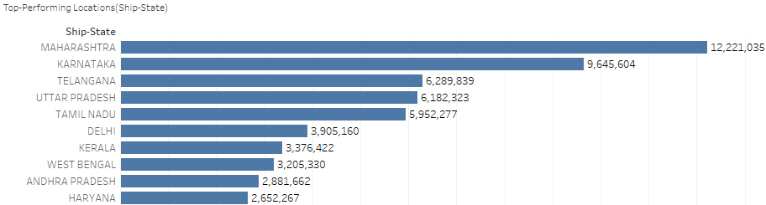
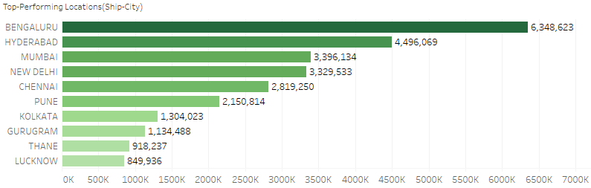
CUSTOMER INSIGHTS ANALYSIS
Identifying top-performing locations based on sales volume.
Top States Top Cities
Maharashtra, Karnataka and Tamil Nadu dominate both in volume and revenue, with Bengaluru and Hyderabad leading among cities

Slide 11
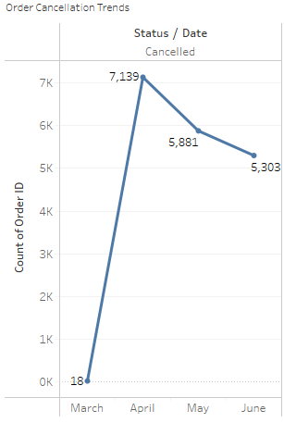
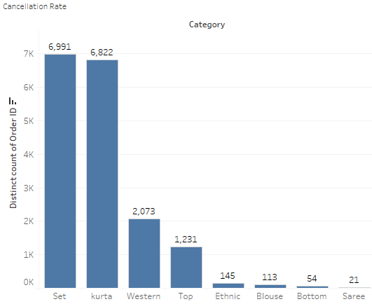
CUSTOMER INSIGHTS ANALYSIS
Analyzing order cancellation trends and customer retention.
Overall cancellation rate: 14..22%
Customer Retention: 52.23%
April has highest number of cancellations. This could be due to inventory, fulfillment, or seasonal demand fluctuations.
Over half of the locations have placed more than one order, indicating moderate retention. This can be improved with loyalty programs or personalized follow-ups

Slide 12
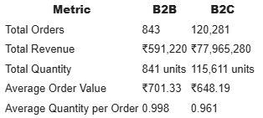
CUSTOMER INSIGHTS ANALYSIS
Differentiating B2B vs. B2C customer behavior for targeted marketing.
B2B is the dominant customer segment in volume and revenue.
B2B orders are fewer but slow slightly higher average value per order-suggesting bulk or premium purchases.
Both segments order approximately 1 item per order, indicating limited bundling or multi-item carts

Slide 13
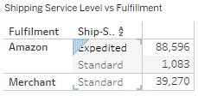
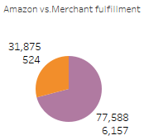
LOGISTICS & FULFILLMENT OPTIMIZATION
Shipping Service Level vs Fulfillment
Amazon vs Merchant fulfillment
Amazon-fulfilled orders show some cancellations and unshipped issues- possibly due to system updates or operational handoffs
Merchant-fulfilled orders are more cleanly categorized (either shipped or not present).

Slide 14
LOGISTICS & FULFILLMENT OPTIMIZATION
Improving order processing for faster deliveries.
Optimize standard shipping offers: Promote standard delivery for low urgency skus to reduce expedited shipping costs.
Leverage amazon fulfillment for high-volume skus: Consider migrating top-selling or frequently returned items to amazon fulfillment to benefit from their high processing speed.
Investigate unshipped amazon orders: The 116 unshipped records under amazon suggest potential syncing issues or backorder delays – requiring follow-up.
Monitor daily merchant capacity: Merchants should not exceed their 200-250 daily shipment threshold without expanding resources.

Slide 15
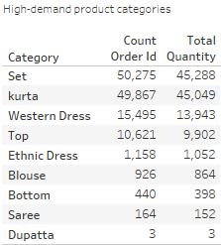
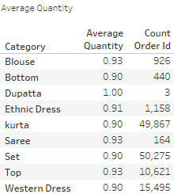
PRODUCT MANAGEMENT & INVENTORY OPTIMIZATION
Identifying high-demand product categories.
Analyzing the average quantity ordered for efficient stock management.

Slide 16
PRODUCT MANAGEMENT & INVENTORY OPTIMIZATION
Enhancing inventory control to prevent stockouts or overstocking
1.Critical stock categories:
Set and kurta: Require active inventory monitoring due to high demand.
Consider dynamic restocking (weekly/monthly) based on rolling average sales
2.Low velocity / overstock risk:
Dupatta, saree, bottom: Low order count and volume. Optimize stocking and avoid bulk replenishment.
3.Stocking strategy:
Maintain a "min-max" stock level policy using historical average quantity and sales velocity.
Example: if kurtas sell ~1 per order, and 45,000 units were sold in total, keep safety stock based on peak season sales rate.

Slide 17
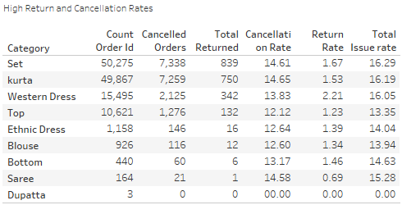
CUSTOMER SATISFACTION & RETURNS
Investigating high return and cancellation rates.

Slide 18
CUSTOMER SATISFACTION & RETURNS
Identifying problematic products/categories to enhance quality.
Set, Kurta, Western Dress, Bottom are the most problematic categories each with 15 - 16% Issue Rate
Improving customer experience through better service policies
Product Quality Checks:
High returns indicate possible fit/size issues or misleading photos/ descriptions.
Prioritize QC for Sets, Kurtas, and Western Dresses.
Size & Fit Guidance
Include detailed size charts, model sizing references, and customer feedback summaries on product pages.
Flexible Cancellation/Return Windows
Early cancellations may be due to buyer’s remorse or unclear shipping expectations.
Consider adding "cancel within 1 hour" button to reduce downstream fulfillment waste.
Enhanced Product Descriptions
For top-cancelled SKUs, review and revise product titles, images, fabric info, and return policy visibility.

Slide 19
CONCLUSION ANALYSIS
Based on the comprehensive analysis of the sales data, several key insights have been identified across various aspects of the business:
Financial performance: Revenue peaked in April 2022 before declining; further analysis is needed to stabilize growth. Average order value helps track customer spending and promotional impact.
Product & inventory: Set and Kurta drive demand, requiring dynamic restocking; dupatta, saree, and bottom have low sales, calling for optimized stocking.
Customer insights: key markets include Maharashtra, Karnataka, and Tamil Nadu, with Bengaluru, Hyderabad, and Mumbai as top cities; B2B vs. B2C patterns highlight the need for tailored strategies.
Returns & cancellations: High issue rates in Set, Kurta, Western dress, and bottom categories point to improvements needed in quality, sizing, and descriptions.
Customer retention: Strong repeat purchase behavior indicates good loyalty that can be enhanced by reducing product issues and improving service.
Logistics & fulfillment: Amazon handles higher order volumes; shifting high-demand skus to amazon and resolving unshipped orders can boost efficiency.

Slide 20
RECOMMENDATIONS
Based on the analysis, here are some recommendations:
Reduce returns & cancellations: Improve product quality, sizing details, and descriptions for high-issue categories like Set, Kurta, Western dress, and bottom.
Inventory optimization: Use dynamic restocking for fast-selling items (Set, Kurta) and avoid overstocking slow movers (dupatta, saree, bottom).
Fulfillment efficiency: Investigate unshipped amazon orders to improve delivery performance.
Leverage amazon fulfillment: Allocate high-volume skus to amazon for faster and more reliable handling.
Monitor merchant capacity: Track merchant-fulfilled volumes to ensure readiness for demand surges.
Utilize sales insights: Apply weekly sales trends and B2B vs. B2C analysis for smarter staffing, inventory, and targeted marketing.

Slide 21
THANK YOU
LinkedIn id: https://www.linkedin.com/in/amrita-saha-data-scientist-data-analyst-data-engineer/
GitHub: https://github.com/Amrita8

